Slide 1



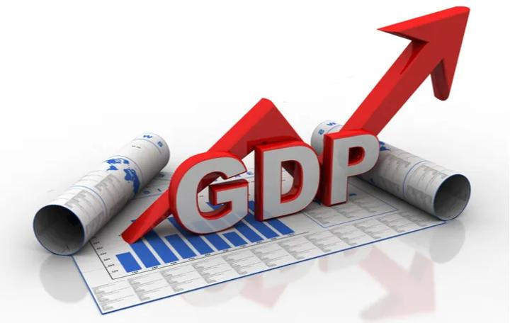
ANALYSING, FORECASTING & PREDICTING FINANCIAL TRENDS
TIME SERIES MODELING

Slide 2

TARGET AUDIENCE
Investors
Taxpayers
Gvmnt Policy Makers
Economists
Business/Financial Analysts

Slide 3

Matters on the Docket
A brief look at what we will discuss in this presentation
01
Highlights and Key Updates
02
Project Goals & Objectives
03
Terminologies
04
Process Flow & Visualizations
05
Modeling
06
Limitations, Findings & Conclusion

Slide 4

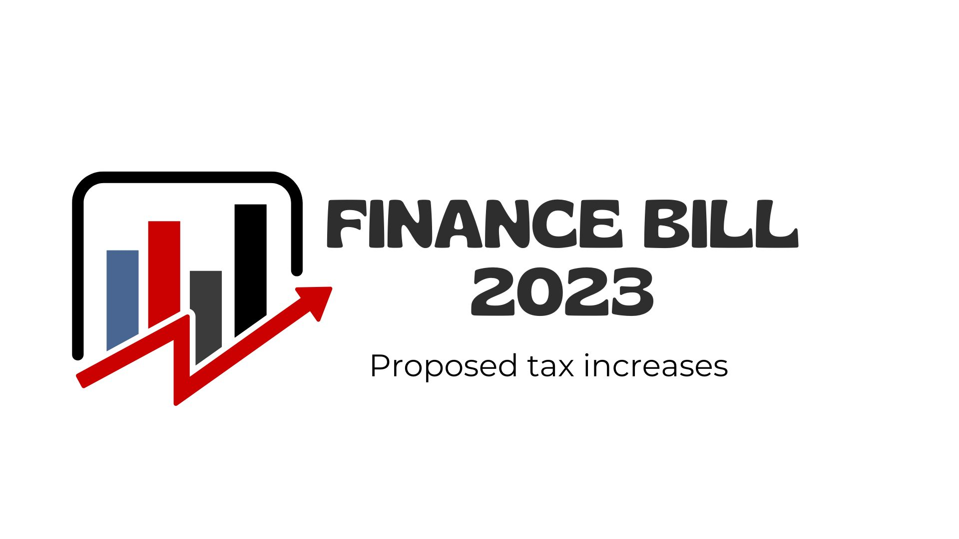
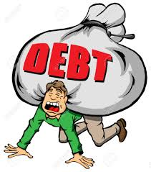

GOVERNMENT’S COMMITMENT TO THE PEOPLE
Passed to law by Parliament on 26th June 2023
Sealing Revenue Leakages Through Tax Avoidance & Evasion
Contain Expenditures & Boost Revenues
Measure of Success: Tax as a %ge of GDP > 15% by 2023/2024

Slide 5


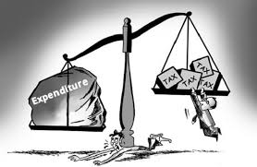
DEBUNKING THE NUMBERS
KES. 700B
Budget Deficit
20% of GDP
External & Domestic Financing
KES. 2.6T
KES. 2.6T
Tax Revenue Collections
71% of Total Budget
16% of GDP
KES. 3.7T
KES. 3.7T
Revenue: Funding Plan?
KES. 0.4B
KES. 0.4B
Expenditure
Total Approved Budget
Set aside to meet BETA priorities
22% of GDP
Ministerial-Appropriation-in-Aid
9% of Total Budget
2% of GDP
KES. 3.0B
KES. 3.0B
Total Projected Revenues
80% of Total Budget
18% of GDP
**BETA: Bottom-up Economic Transformation Agenda

Slide 6
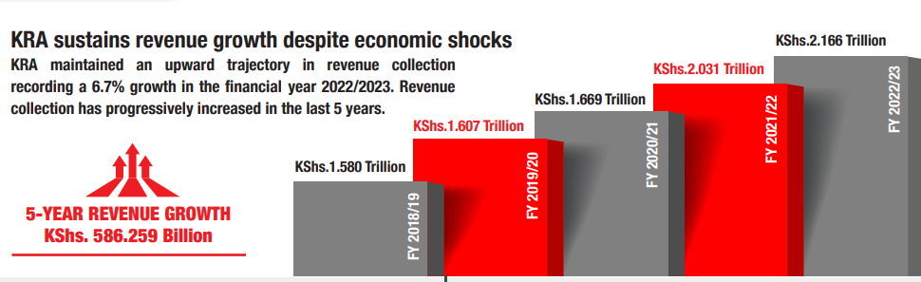
TAX REVENUE COLLECTION TRENDS
6.7%
21.7%
3.9%
1.7%
Kes. 2.9Trillion FY 2023/24 Gvmnt Target (32% YoY Growth)???
The Government feels the ratio of tax revenue as a percentage of Gross Domestic Product (GDP) being well below acceptable levels to enable spur economic growth & reduce cost of living.

Slide 7

What is Tax-to-GDP-Ratio?
Measure of a Nation's tax revenue relative to the size of its economy
This ratio is used with other metrics to determine how well a Nation’s Government directs its economic resources via taxation.
What Is a Good Tax-to-GDP-Ratio?
>15%
A tax-to-GDP ratio of 15% or higher ensures economic growth and, thus, poverty reduction in the long-term, according to the World Bank
***Tax Revenues Generally Rises & Fall Faster than GDP, but Ratio Stay’s relatively Consistent Barring Extreme Swings in Growth

Slide 8
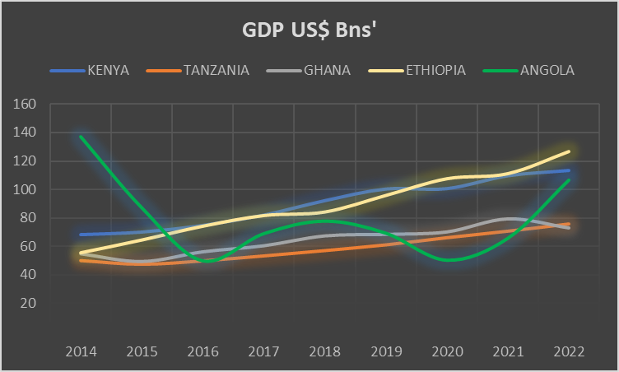
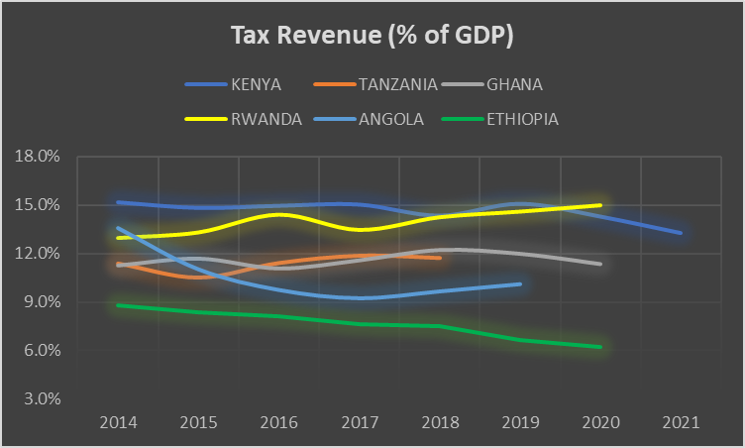
GDP LEAGUE TABLE
IS GDP GROWING PROPORTIONATELY TO PROJECTED TAX REVENUE COLLECTIONS?
ARE THERE ALTERNATIVE SOLUTION TO SPUR ECONOMIC GROWTH?

Slide 9




GOALS & OBJECTIVES
01
The goal of the project is to study how Kenya's economy has performed in the past (GDP trends) and use that information to predict how it might grow in the future.
02
Project shall aim to analyze Country's historical GDP trends and forecast future GDP growth using Machine Learning Algorithm.
03
The analysis shall assist provide insights into economic growth patterns, identify emerging trends, and support evidence-based decision-making for various stakeholders.

Slide 10
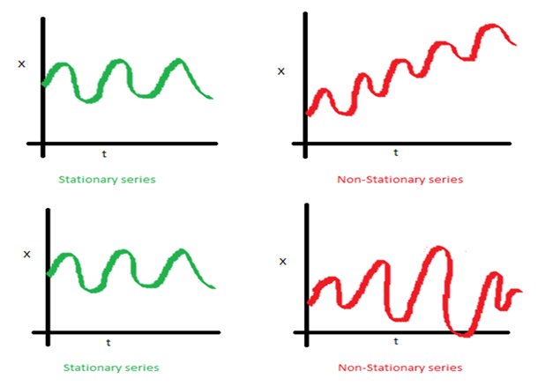
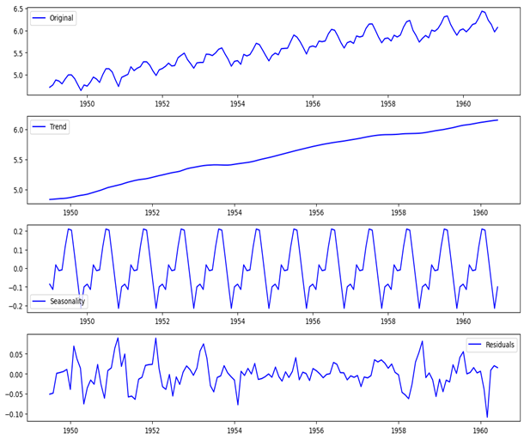
TIME SERIES MODELING TERMINOLOGIES & CONCEPTS
TIME SERIES STATIONARITY, DETRENDING & DICKEY-FULLER TEST
TIME SERIES DECOMPOSITION

Slide 11
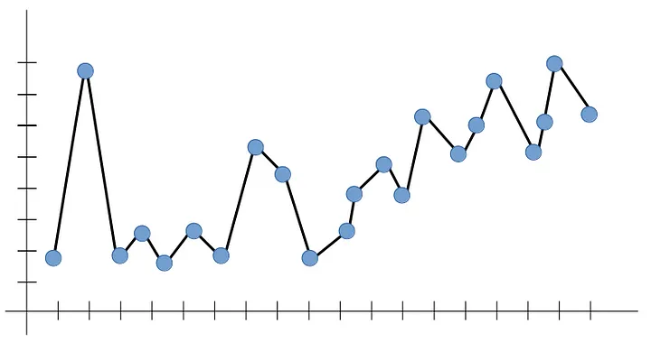
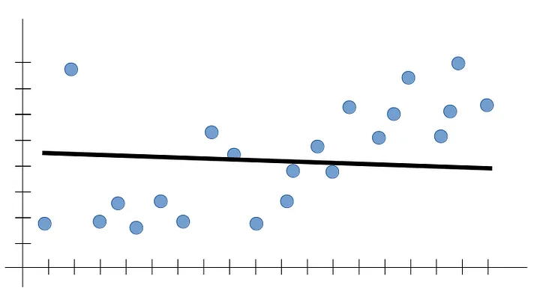
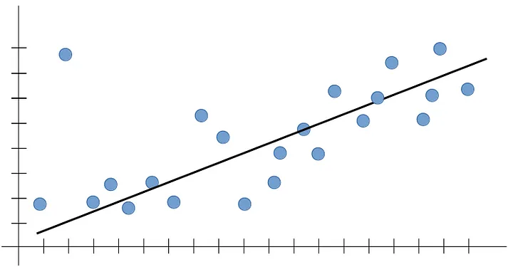
Terminologies: cont’d
The essence is to capture the dominant trend and fit our line within that trend.
MODEL OVERFITTING
MODEL UNDERFITTING
BEST FIT

Slide 12
Slide 9
PROCESS FLOW (CRISP-DM)
Business Understanding
Modelling
Deployment
What problem we trying to solve
Stakeholders/Target Audience
Expected Impact
Project Motivation
Plotting ACF & PACF Plots
Model Selection: AR, ARIMA,SARIMA
Fit Model with optimal parameters
Data Understanding & Preparation
Evaluation & Prediction
Data Source (world bank website)
Dealing with Data Types, Missing Values
Understanding Dataset Distribution
Checking Multicollinearity between preds
Feature Importance
Detrending TS using Differencing
Stationarity Test using Dickey Fuller Test
Model Evaluation: MSE Score
Model Prediction & Forecasting
***CRISP-DM: -CRoss Industry Standard Process for Data Mining
***ACF: Auto-Correlation Function; PACF: Partial Auto-Correlation Function; MSE: Mean Squared Error

Slide 13
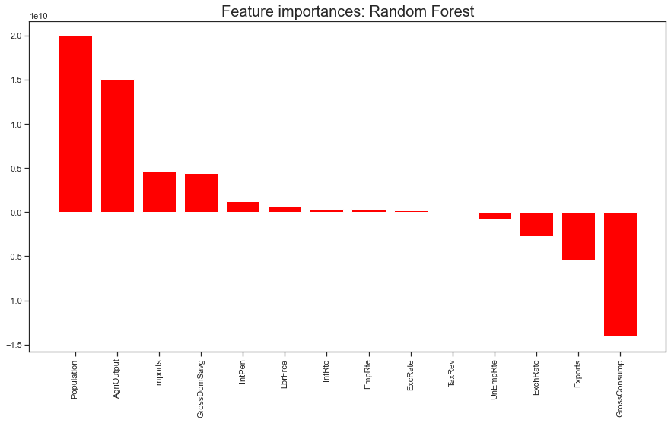
FEATURE IMPORTANCE: the scores represent the “importance” of each feature
A higher score means that the specific feature will have a larger effect on the model that is being used to predict our target variable (GDP).

Slide 14
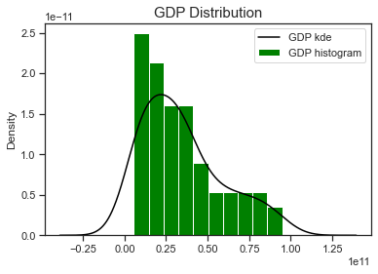
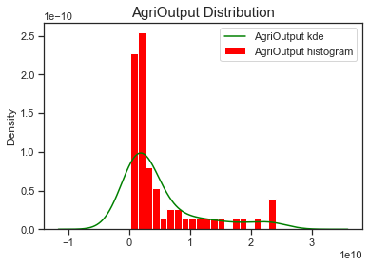
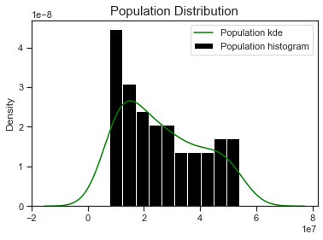
Checking for Linearity: Visualizing Distributions (Univariate Analysis)
Variables tend to follow a particular distribution – Although Not Perfectly Normal (Positively Skewed).

Slide 15
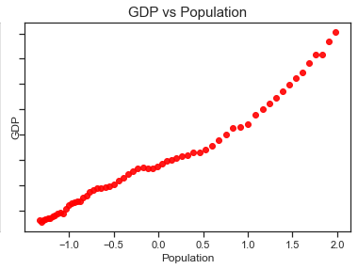
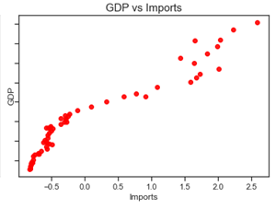
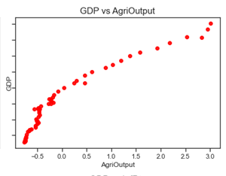
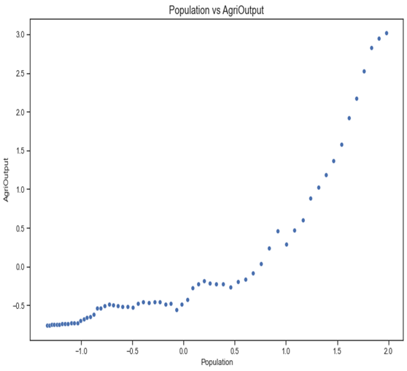
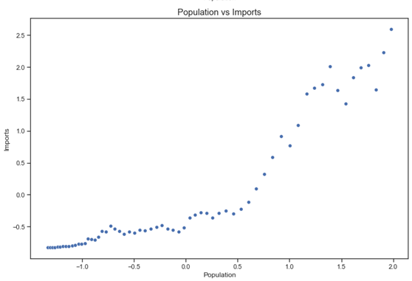
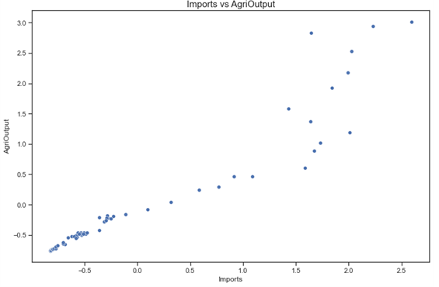
Bi-variate Analysis: Strong +ve Linear Relationship between Target & Variables
Variables vs GDP
Corr = 0.96
Corr = 0.95
Corr = 0.98
Population vs AgriOutput
Population vs Imports
Imports vs AgriOutput
~ Variables
Corr = 0.93
Corr = 0.95
Corr = 0.89

Slide 16
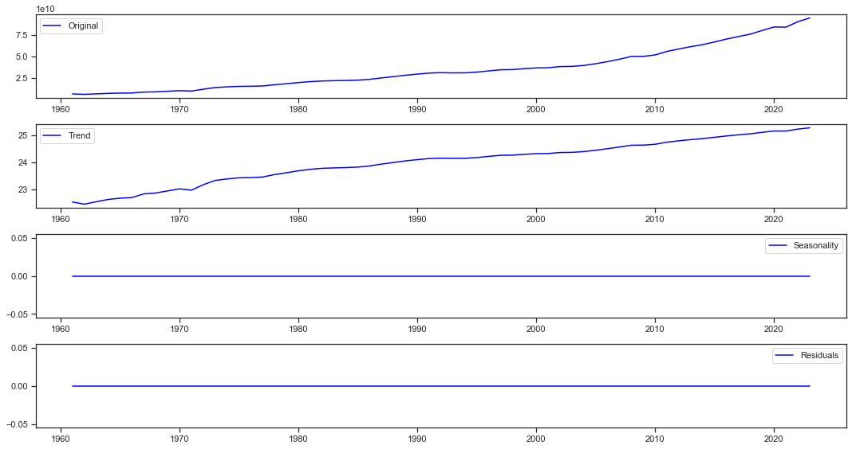
Our GDP Time series visualization (Trends & Seasonality)
DECOMPOSED TIME SERIES
NO SEASONALITY

Slide 17
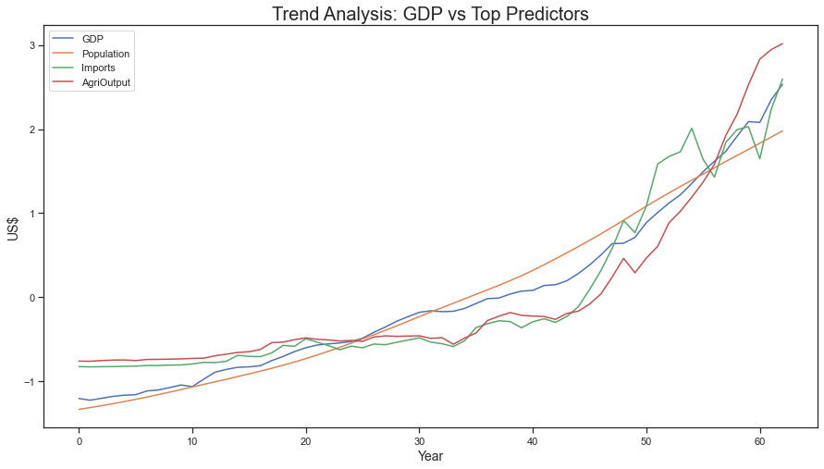
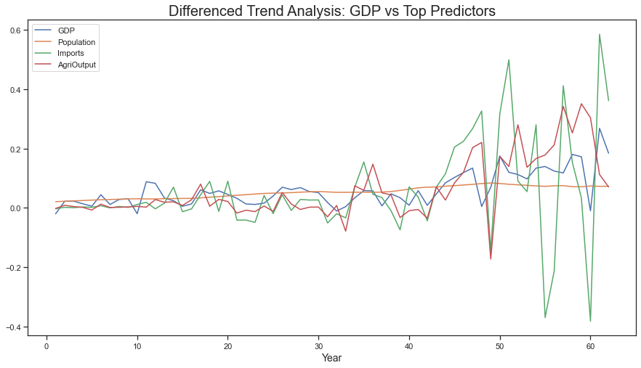
Time series visualization (Stationarity Check)
Differencing done to make our Data Stationary

Slide 18
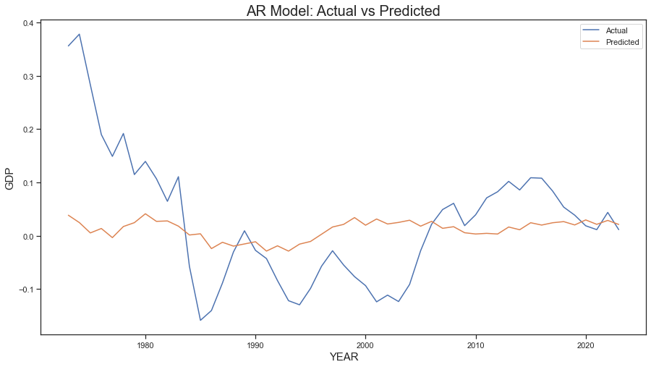
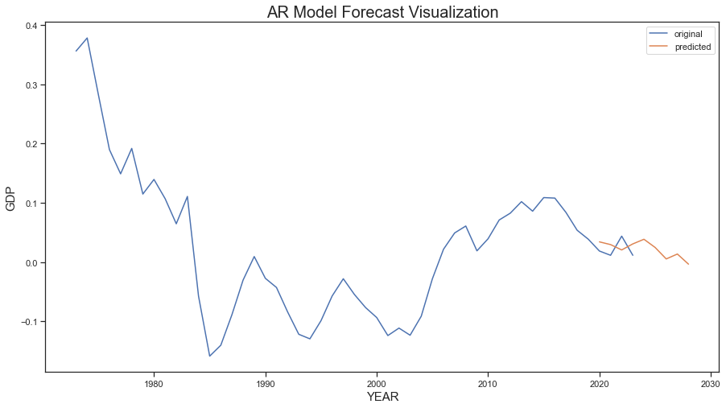
Modeling: Auto-Regressive (AR) Model Results

Slide 19
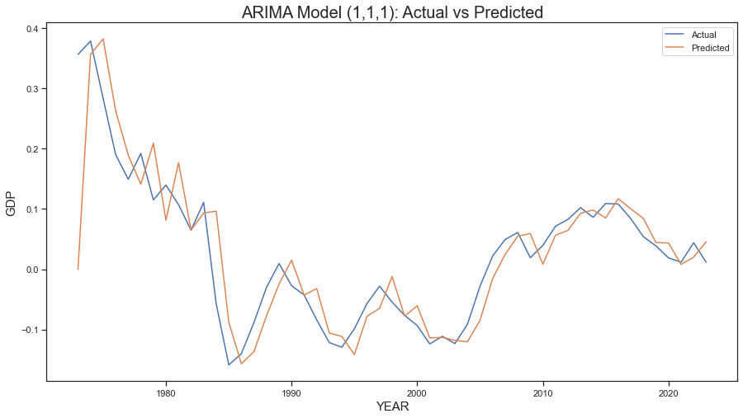
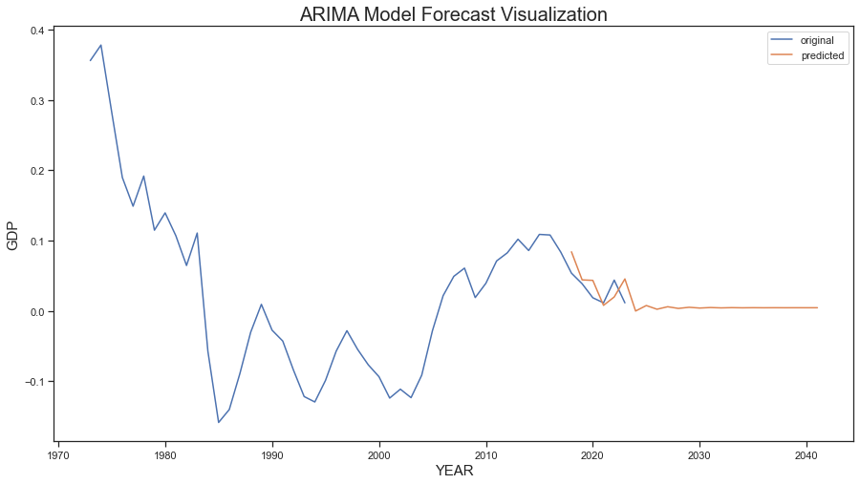
Modeling: ARIMA Model Results

Slide 20
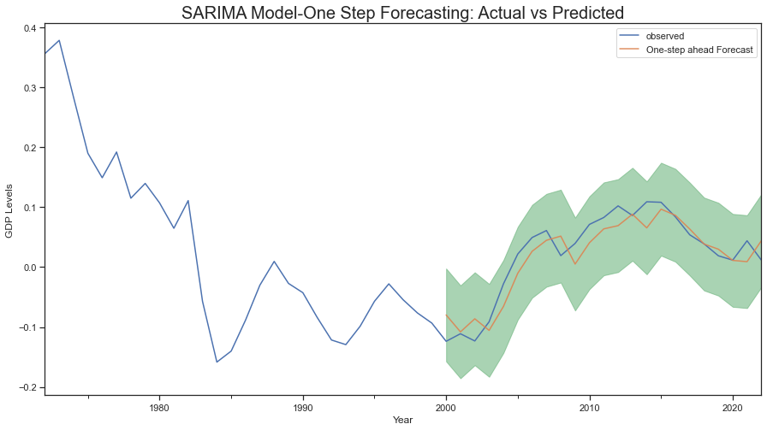
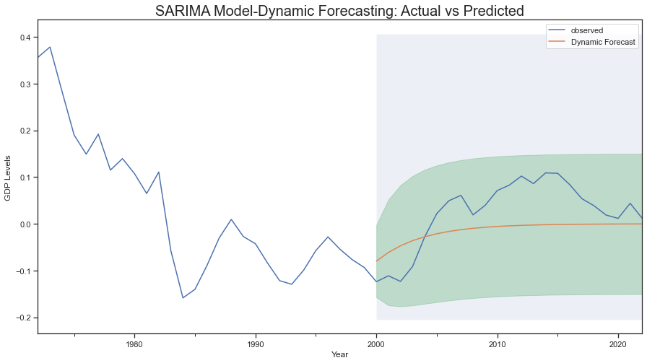
Modeling: SARIMA Models Results

Slide 21
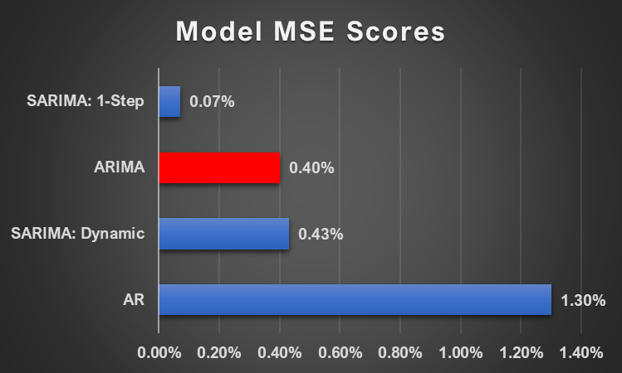
MODELING: EVALUATION & SELECTION CRITERION
About Mean Squared Error (MSE):
Checks how close estimates or forecasts are to actual values
The lower the MSE, the better the model’s performance (closer is forecast to actual)
The MSE of SARIMA: 1-Step Ahead forecasts yields a value of close to or equal to zero, which is very low.
!!!! An MSE that is close to 0 indicates that the estimator is predicting observations of the parameter with perfect accuracy, which would be an ideal scenario, but it is not typically possible.
MODEL SELECTED: ARIMA

Slide 22
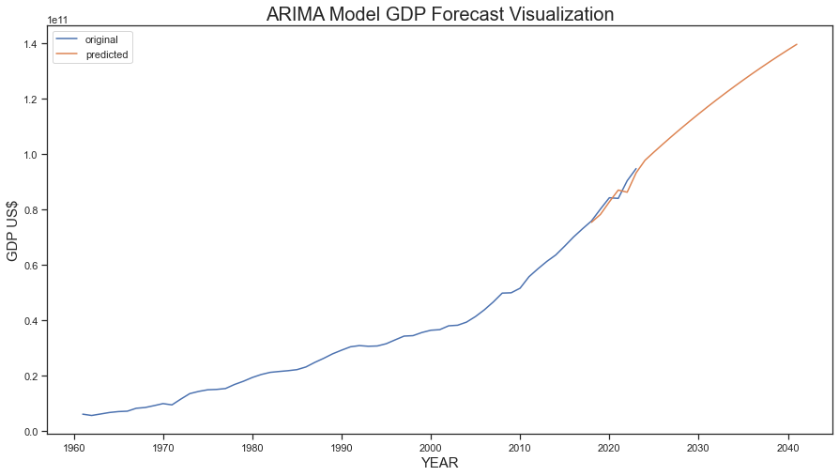
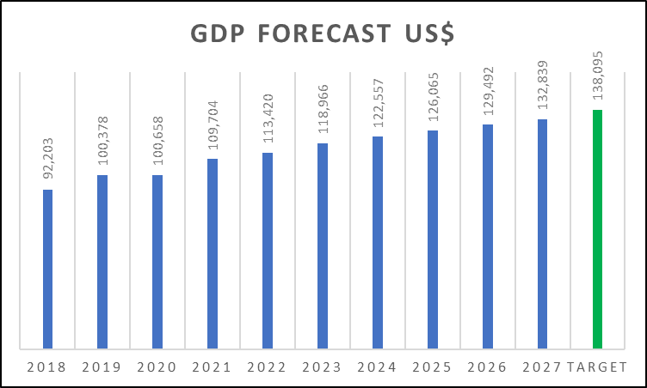
MODELING: DEPLOYMENT & RESULTS

Slide 23

MODEL LIMITATIONS
Missing Data
May Lead To Inaccurate Results In The Long Term (Changing Dynamics / Policies)
Model Deployment (Firewall & Port Restriction)

Slide 24
Can Raising Taxes Help the Economy?
FINDINGS & CONCLUSION
In the Short Term – Next 1-2 years
1
Cutting Taxes: Boost demand in Economy (Increase Workers Take-Home & Business After-Cash Flows; Increased Hires & Investments/expand activities).
2
In the Long Term
Cutting Taxes: Induce people to work more; Increase Labor Force; Encourage savings as Firms invest locally (rather than internationally); Encourage creation of new ideas thru research; Slow Economic Growth; Increasing Deficits; Workers might choose to work less due to increased after-tax-income;
3
Difficult to Analyze How Raising Taxes Impact Economy
Policy changes never happen in a vacuum – multiplicity of factors contribute to economic growth or decline, difficult to isolate the effects of raising (or lowering) taxes.

Slide 25
RECOMMENDATIONS
Individuals: Individuals should review their tax withholdings and make sure that they are paying the correct amount of tax. They may also want to consider making changes to their investment portfolios in order to minimize their tax liability.
Small businesses: Small businesses should seek professional advice to help them understand the impact of the new taxes on their operations. They may also want to consider joining a trade association or other group that can provide them with support and guidance.
For the government: The government should monitor the impact of the new taxes on the economy and make adjustments as needed. They should also be prepared to address any legal challenges to the bill.

Slide 26









THANK
YOU!!

Slide 27

Shadrack Cheruiyot
Elizabeth Omao
Darvin Kerubo
Marvin Agumba
Mary Murugami
TEAM 4 MEMBERS

